Slide 1



DEPI - Final Presentation
Building and Securing a Small Network

Slide 2
DEPI - Final Presentation
Members
01
02
03
Ahmed Sameh
Mohamed Elhenawy
Kerolos Wageh
04
05
Mostafa Yasser
06
Hany Kameel
Mohamed Khaled

Slide 3
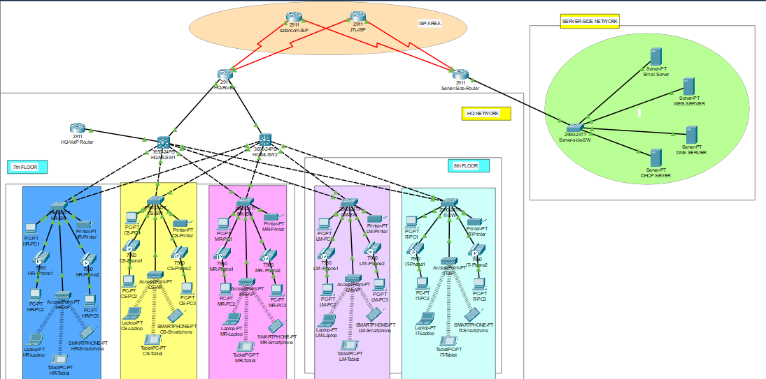
DEPI - Final Presentation

Slide 4
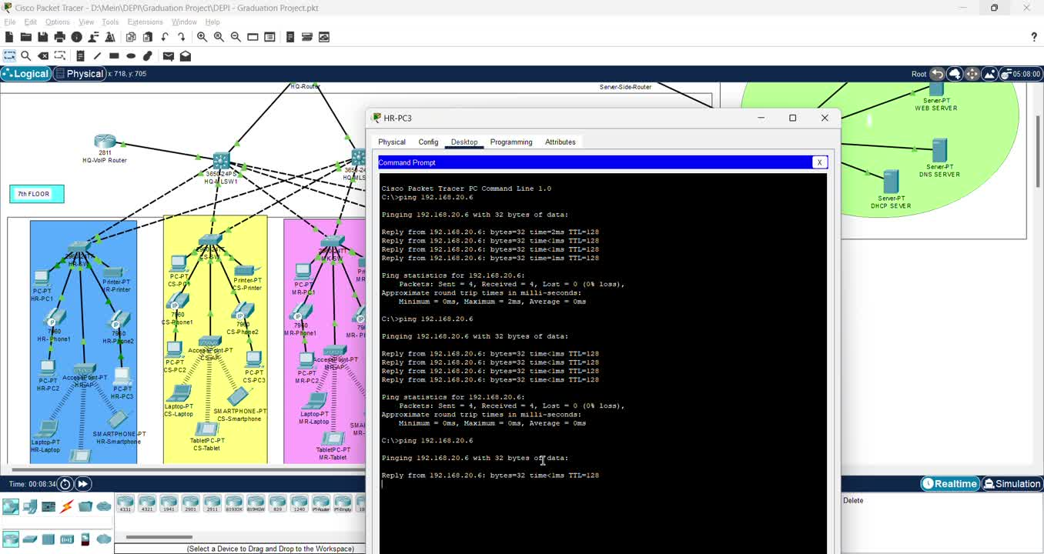

Slide 5
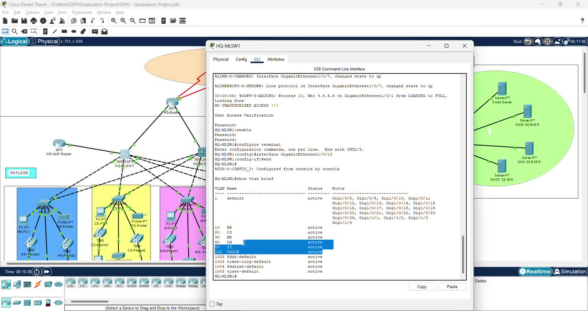

Slide 6
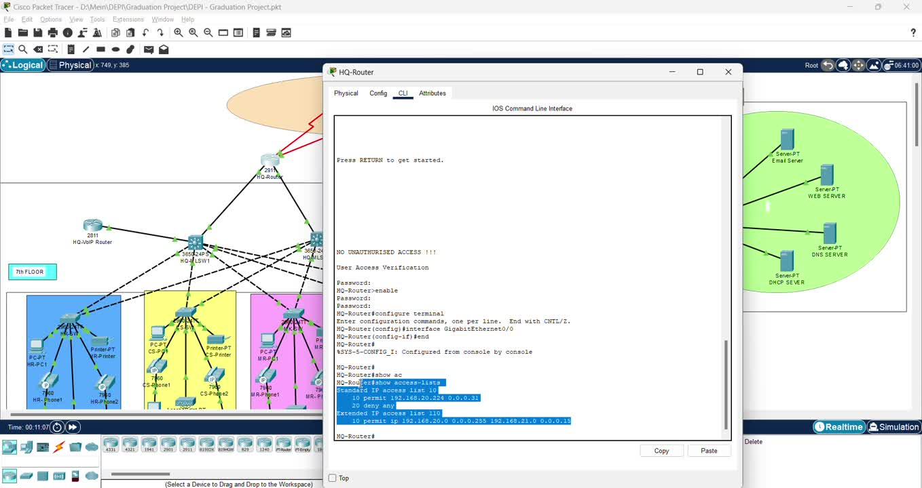

Slide 7
DEPI - Final Presentation
Thank
You

